Slide 1
Week 5 Qualitative Research Design and Methods Overview INFT 4017

Slide 2
Introduction
Methodology concerns how we can find out – it’s an approach. It may include but not limited to:
Recruitment and selection of human participants/animals/objects
Data collection methods
Data analysis – coding, statistical analysis
Evaluation of methodology – credibility, replicability, transferability, triangulation
Ethics application and approval
Partnership building with industries and end-user communities
Pilot study
Notes:
Methodology is a broader concept than methods.

Slide 3
Research design
At the most general level, research design means all the issues involved in planning and executing a research project – from identifying the problem through to reporting and publishing the results.
Qualitative research
Quantitative research
Notes:
Often, disseminating research results requires beyond the academia.

Slide 4
Practically, research design (for both qualitative and quantitative studies) situates the researcher in the empirical world, and connects research questions to data (Punch, 2014).

Slide 6
Example of a conceptual framework
See Dr. Safirotu Khoir’s PhD thesis – Figure 2.3
Conceptual framework for Asian immigrants’ information behaviour and settlement
http://search.ror.unisa.edu.au/record/UNISA_ALMA11145033080001831/media/digital/open/9916131699901831/12145033070001831/13145033060001831/pdf

Slide 7
Qualitative research
Qualitative research is research that seeks an in-depth understanding of human behaviour at individual, group, cultural, social and/or population levels.
Samples are typically small
The aim is to understand the underlying themes or concepts.
Researcher must make him/herself visible and explicit

Slide 8
Steps for conducting qualitative research (Creswell, 2009, p. 187):
Identify the specific design that you will be using and provide references to the literature that discusses the approach.
Provide some background information about the design.
Discuss why it is an appropriate strategy to use in the proposed study.
Identify how the use of the design will shape many aspects of the design process.

Slide 9
Qualitative research design
According to Case (2012, p. 205), there are several stages of research process, namely:
1. Identifying a research question
2. Determining what data are needed and designing a specific study to collect it
3. Choosing and implementing research methods
4. Analysing and interpreting observations
5. Considering the overall results

Slide 10
There are several methods we can use to conduct research.
The specific ways, tools, and techniques of observation and measurement are what we call “methods” (Case 2012, p. 202).

Slide 11
Analysis of qualitative data
Qualitative data are in the form of (Neuman, 2011):
text from documents,
observational notes,
open-ended interview transcripts,
physical artifacts,
audio or video tapes, and
images or photos.

Slide 12
Purpose of qualitative data analysis (Wildemuth, 2009)
Systematically to organize, integrate, and examine
Search for patterns and relationships among the specific details
Connect particular data to concepts, advance generalizations
Identify broad trends or themes

Slide 13
Conceptualisation, coding and theory building (Neuman, 2011)
Conceptualisation Form new concepts or refine concepts that are grounded in the data.
Conceptulisation is a way to organise and make sense of data.
Performing analysis by organising data into categories based on themes, concepts, or similar features.

Slide 14
Coding qualitative data
Organise the raw data into conceptual categories and create themes or concepts.
qualitative coding is an integral part of data analysis.
Your research questions provide a guide, but the process often leads to new questions.

Slide 15
Open coding
You locate themes and assign initial codes in your first attempt to condense the mass of data into categories.
As you slowly read data, you look for critical terms, key events or themes.
Remain open to creating new themes and to changing these initial codes in subsequent analysis.

Slide 16
An example study (Du, 2014)
This study was designed to investigate the stages of the information journey within the context of the everyday work-related information activities of marketing professionals.
Research questions:
RQ1. What are the stages of marketing professionals’ information journey?
RQ2. What are the characteristics of each stage of marketing professionals’ information journey?
RQ3. What are the relationships between the stages of marketing information journey?

Slide 17
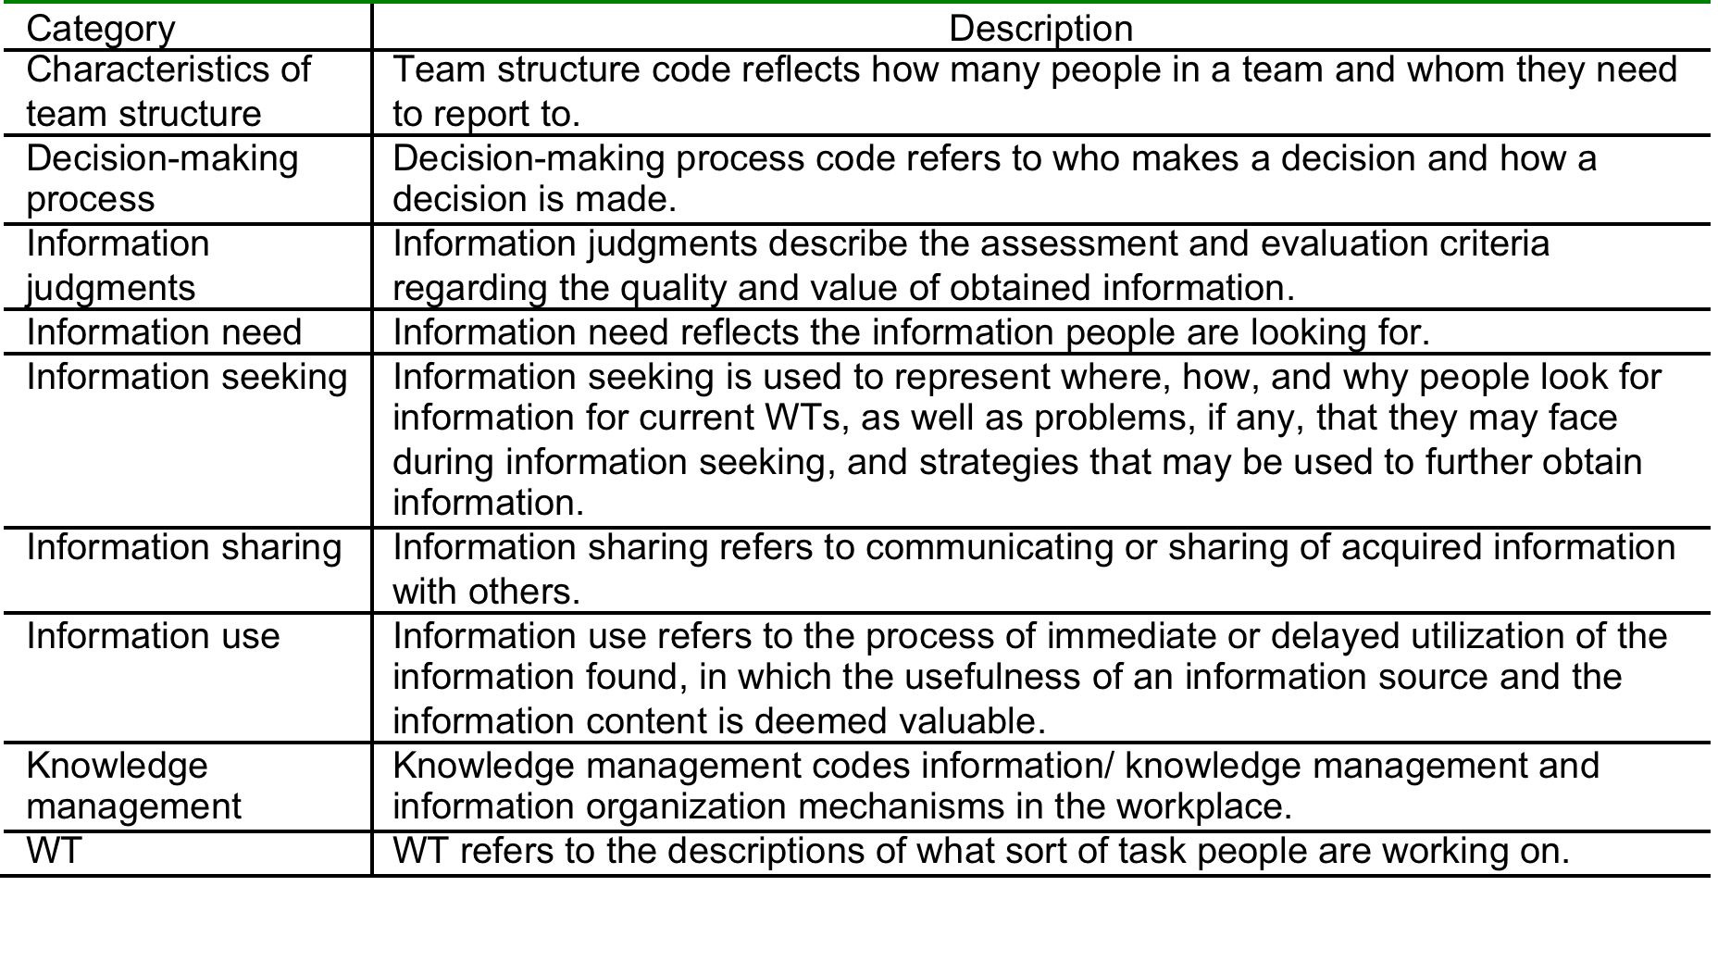
TABLE. Coding scheme. (Du, 2014)

Slide 18
Information journey model (Du, 2014)
Work task completion (Yes/Part of/No)
Work task
Stage 1
Work task – generated information need
Multiple information sources
Gaps (Problem encountered)
Stage 4
Making sense and use
of found information
Stage 5
Information sharing
and collaboration
Stage 2
Work task – oriented information seeking
Gaps (Problem encountered)
Gap-bridging techniques in information use
Stage 3
Judgment and evaluation of obtained information
Information obtained
Gap-bridging techniques used in information seeking

Slide 19
Methodology assignment in this course
As you are writing a literature survey paper (research paper assignment) that reviews existing work, you need to analyse the papers of your readings to determine:
common elements,
how well they perform at what they claim to do
strengths/advantages or weaknesses/disadvantages
how they compare to each other
Identification of research gaps
Form research questions based on the gaps identified
Summarise research trends and point out future research directions

Slide 20
References
Case, DO 2012, Looking for information: A survey of research on information seeking, needs, and behavior, 3rd edn, Academic Press, Amsterdam.
Creswell, J.W. 2009. Research Design: Qualitative, Quantitative and Mixed methods Approaches. SAGE Publications, London.
Punch, K. (2014). Introduction to social research. Chapter 7.
Neuman, W. L. (2011). Social research methods: qualitative and quantitative approaches. Chapter 15.
Wildemuth (2009). Applications of social research methods to questions in information and library science. Chapter 29.

